Slide 1


Session - 03
Formatting Text
Using Tags
Prepared by: Sir Muhammad Hamza
1

Slide 2
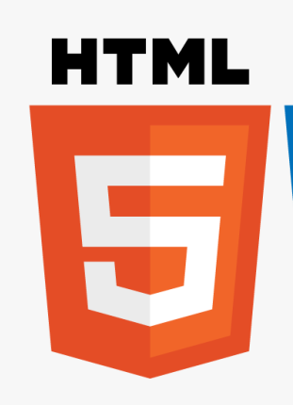

Objectives
Explain the Heading tag
Explain the different tags related to formatting
Explain the monospaced font, preformatted text and block quotation
Describe the different types of lists
Explain the procedure to change the background color and image
Prepared by: Sir Muhammad Hamza

Slide 3
Introduction
Text content of Web page forms an important part of a Website.
Text must be attractive, easy to read, and should be short and crisp.
Text formatting options such as bold, italics, superscript, subscript, and so on must be applied to attract the user's attention.
Background color and image of the Web page can be specified using HTML.
Prepared by: Sir Muhammad Hamza
3

Slide 4
Heading 1-2
Heading elements define headings for contents such as text and images.
Specifies the hierarchical structure of a Web page by grouping the contents.
Specifies the hierarchical structure of headings ranging from H1 to H6
H1 is the top level heading and is displayed with largest font size
H6 is the lowest-level heading and is displayed with smallest font size
Prepared by: Sir Muhammad Hamza
4

Slide 5
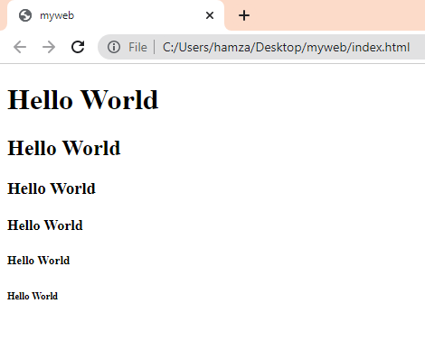
Heading 2-2
<!DOCTYPE html>
<html lang="en">
<head>
<title>myweb</title>
</head>
<body>
<h1>Hello World</h1>
<h2>Hello World</h2>
<h3>Hello World</h3>
<h4>Hello World</h4>
<h5>Hello World</h5>
<h6>Hello World</h6> </body>
</html>
Prepared by: Sir Muhammad Hamza
5

Slide 6
HGROUP
The <hgroup> tag in HTML stands for heading group and is used to group the heading elements. The <hgroup> tag in HTML is used to wrap one or more heading elements from <h1> to <h6>, such as the headings and sub-headings. The <hgroup> tag requires the starting tag as well as ending tag.
Note: <hgroup> is deprecated from HTML5 specification.
<!DOCTYPE html>
<html>
<body>
<!--HTML hgroup tag starts here-->
<hgroup>
<h1>This is the title.</h1>
<h2>This is sub-title.</h2>
</hgroup>
<!--HTML hgroup tag ends here-->
</body>
</html>
Prepared by: Sir Muhammad Hamza
6

Slide 7
Basic Tags 2-9
HTML contains several elements for defining text with a special meaning.
Tag | Description
<b> | Bold text
<strong> | Important text
<i> | Italic text
<em> | Emphasized text
<mark> | Marked text
<small> | Smaller text
<del> | Deleted text
<ins> | Inserted text
<sub> | Subscript text
<sup> | Superscript text
Prepared by: Sir Muhammad Hamza
7

Slide 8
Element 2-2
Prepared by: Sir Muhammad Hamza
8

Slide 9
DOCTYPE
All HTML documents must start with a <!DOCTYPE> declaration.
The declaration is not an HTML tag. It is an "information" to the browser about what document type to expect.
In HTML5, the <!DOCTYPE> declaration is simple:
<!DOCTYPE html>
Prepared by: Sir Muhammad Hamza
9

Slide 10
Basic Tags 1-9
An HTML document is made up of different elements, tags, and attributes, which specify content and its format.
HTML is both a structural and presentational markup language.
Structural markup specifies structure of content, while presentational markup specifies format.
An HTML page is saved with . html extension.
Prepared by: Sir Muhammad Hamza
10

Slide 11
Basic Tags 2-9
Basic structure of an HTML document mainly consists of seven basic elements:
Tag Name | Tag
html | <html>
head | <head>
title | <title>
meta | <meta>
link | <link>
script | <script>
body | <body>
Prepared by: Sir Muhammad Hamza
11

Slide 12
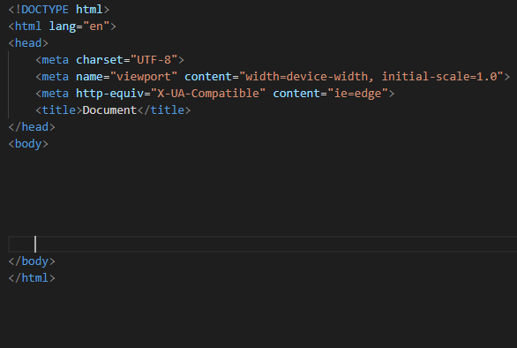
Basic Tags 3-9
HTML
START TAG
The html element is the root element that marks the beginning of an HTML document.
It contains start and end tag in the form of <html> and < /html> respectively. It is the largest container element as it contains various other elements.
End TAG
Prepared by: Sir Muhammad Hamza
12

Slide 13
Basic Tags 5-9
TITLE
The title element allows you to specify title of the Web page under <title> and </title> tags.
The title is displayed on the title bar of the Web browser. The title element is included within the head element.
START TAG / End TAG
Prepared by: Sir Muhammad Hamza
13

Slide 14
Basic Tags 6-9
META
SELF CLOSING TAG
The meta tag is used for displaying information about the data.
In HTML5, the content meta tag which was used for specifying the charset or character encoding has been simplified.
The new <meta> tag is as follows:
<meta charset="utf-8" />
UTF-8 is the most commonly used character coding that supports many alphabets. There are several other attributes associated with the meta tag that can be used to declare general information about the page.
This information is not displayed in the browser.
Meta tags provide search engines, browsers, and Web services with the information that is required to preview or acquire a summary of the relevant data of your document. A
Prepared by: Sir Muhammad Hamza
14

Slide 15
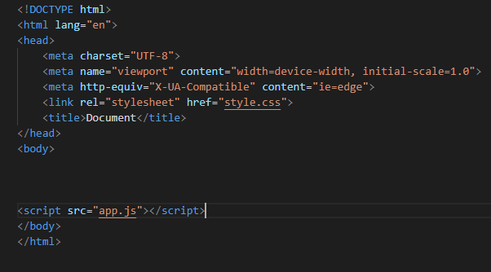
Basic Tags 7-9
LINK
The <link> tag is used to define the association between a document and an external resource.
It is used to link style sheets. Its type attribute is used to specify the type of link such as ‘text/css' which points out to a style sheet.
<link type="text/css" rel="stylesheet" href=“style.css">
The type attribute is not included in HTML5.
The reason is that CSS has been declared as the default and standard style for HTML5. So, the new link is as follows:
<link rel="stylesheet" href=“style.css">
SELF CLOSING TAG
Prepared by: Sir Muhammad Hamza
15

Slide 16
Basic Tags 8-9
SCRIPT
With HTML5, JavaScript is now the standard and default scripting language.
The type attribute tag can be removed from the script tags.
START TAG / End TAG
Prepared by: Sir Muhammad Hamza
16

Slide 17
Basic Tags 9-9
BODY
The body element enables you to add content on the Web page specified under the <body> and </body> tags.
Content can include text, hyperlinks, and images. You can display the content using various formatting options such as alignment, color, and background.
The following figure shows the basic HTML elements:
START TAG
End TAG
Prepared by: Sir Muhammad Hamza
17

Slide 18
Attributes
All HTML elements can have attributes
<p class=“foo”>This is paragraph</p>
Attribute
Attributes provide additional information about elements
Attributes are always specified in the start tag
Attributes usually come in name/value pairs like: name="value”
Prepared by: Sir Muhammad Hamza
18

Slide 19
Attributes
HTML attributes provide additional information about HTML elements
Attribute | Description
class | Multiple HTML elements can share the same class
Example | https://www.w3schools.com/html/html_classes.asp
id | The HTML id attribute is used to specify a unique id for an HTML element.
Example | <h1 id="myHeader">My Header</h1>
style | The style attribute is used to add styles to an element, such as color, font, size, and more.
Example | <p style="color:red;">This is a red paragraph.</p>
Prepared by: Sir Muhammad Hamza
19

Slide 20
Attributes
HTML attributes provide additional information about HTML elements
Attribute | Description
title | The information is most often shown as a tooltip text when the mouse moves over the element.
Example | <p><abbr title="World Health Organization">WHO</abbr> was founded in 1948.</p> <p title="Free Web tutorials">abc.com</p>
href | The <a> tag defines a hyperlink. The href attribute specifies the URL of the page the link goes to:
Example | <a href="https://www.w3schools.com">Visit W3Schools</a>
src | The <img> tag is used to embed an image in an HTML page. The src attribute specifies the path to the image to be displayed:
Example | <img src="img_girl.jpg">
Prepared by: Sir Muhammad Hamza
20

Slide 21
HTML Entities
Some characters are reserved in HTML.
If you use the less than (<) or greater than (>) signs in your text, the browser might mix them with tags.
Character entities are used to display reserved characters in HTML.
&entity_name;
OR
&#entity_number;
(To display a less than sign (<) we must write: &lt; or &#60;)
Prepared by: Sir Muhammad Hamza
21

Slide 22
HTML Entities
HTML attributes provide additional information about HTML elements
Result | Description | Entity Name | Entity No.
 | non-breaking space | &nbsp; | &#160;
< | less than | &lt; | &#60;
> | greater than | &gt; | &#62;
& | ampersand | &amp; | &#38;
" | double quotation mark | &quot; | &#34;
' | single quotation mark (apostrophe) | &apos; | &#39;
¢ | cent | &cent; | &#162;
£ | pound | &pound; | &#163;
© | copyright | &copy; | &#169;
Prepared by: Sir Muhammad Hamza
22

Slide 23
Container and Standalone Tags
There are two types of HTML elements namely, container and standalone elements.
A container element includes the start tag, contents, sub-elements, and end tag.
All the basic HTML elements are container elements.
A standalone element consists of the start tag and attributes followed by the end tag as /> without any content
Container Tags | Standalone Tags
<html></html> | <br/>
<body></body> | <hr/>
<h1></h1> | <img/>
<p></p> | <input/>
<script></script> | <link/>
<div></div> | <meta/>
Prepared by: Sir Muhammad Hamza
23

Slide 24
HTML5 and Mobile Devices
HTML5 helps to create better and richer mobile applications by using APIs that support advanced Web application features for mobile browsers.
New-age smartphones with Apple iOS and Google Android as operating systems support HTML5 compliant browsers.
HTML5 tries to integrate all the features to deploy mobile applications that would be compatible with all the platforms.
HTML5 provides features such as drag-and-drop functionality, video embedding in an application, and even offline capabilities.
As HTML5 is compatible with most mobile operating systems, up to 30% of the cost of development for different CPE rating systems is saved.
Also, there is a reduced dependency on third-party components, thus reducing the licensing costs.
All the required components will be readily available through the browser in HTML5.
Prepared by: Sir Muhammad Hamza
24

Slide 25
Benefits of HTML5 in Mobile Development
HTML5 has included APIs, hence additional plug-ins are not required for mobile browsers.
Mobile development is easier as knowledge of only HTML5, CSS, and JavaScript is majorly required.
There is a rising growth of HTML5 for mobile applications due to its enhanced compatibility.
HTML5 is compatible with most operating
The HTML5-based mobile applications can run on browsers of Android, 10S, Blackberry, Windows Phone, and other mobile operating systems.
The development cost for creating applications in HTML5 is low.
Applications based on location and maps will have greater support in HTML5.
Third-party programs are not required in HTML5.
Prepared by: Sir Muhammad Hamza
25

Slide 26
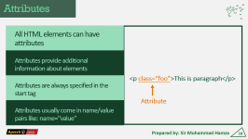
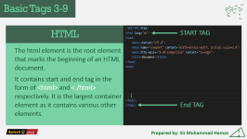
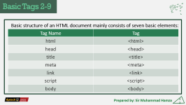
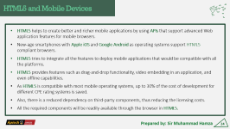
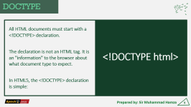
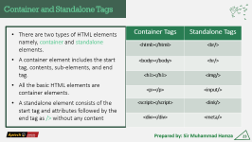
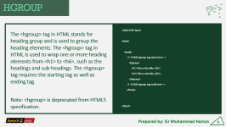
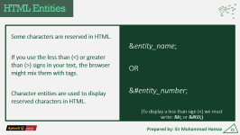
Summary
Prepared by: Sir Muhammad Hamza
26

Slide 27
Session-2 End
Thank You
Any Question?
Prepared by: Sir Muhammad Hamza
27

